Slide 1

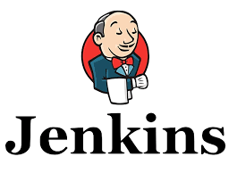


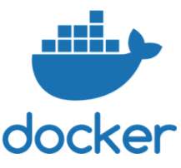
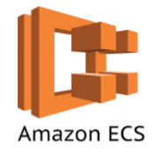




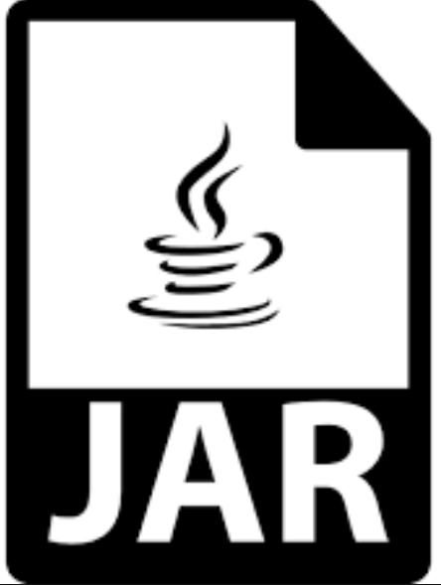
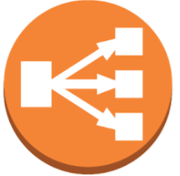



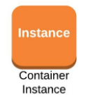
Wickes – Microservices, Containerization & Cloud - CICD Pipeline
Image repo
4
Build and Publish Docker Image to ECR
Deploy Docker Image to ECS
Integrated Test Suit
Publish Docker Image
1
2
3
Cluster
Developers
Code Repo
5
Load Balancer
Configure Task Definition
Code Quality Check
Build JAR files
Jenkins Continuous Integration (CI)
Deploy to container
AWS Containerization

Slide 2
Wickes – Microservices, Containerization & Cloud - CICD Pipeline
Developers pushes code to git.
Jenkins:
Pulls code from git.
Tests the code.(BDD and TDD) Test cases integrated in code.
Perform SonarQube Analysis.
Use Docker Build and publish Plugin to build and publish image.
AWS:
Image pushed to ECR.
Deploying Image from ECR to ECS.
Create a load Balancer.
Create a fargate cluster.
Create a service to run the container inside cluster.
Using Task Definition Run a container inside the service.

